Slide 1
Fraud Awareness Training:
Detection and Prevention

Slide 2
Agenda
  Office of Inspector General Overview
  What is Fraud?
    Who Commits Fraud?
    Why?
    Common Types of Fraud
  Fraud Detection
    Red Flags
    Example Cases
  Fraud Prevention
    What can you do?
  How to report suspected fraud?

Slide 3
Office of Inspector General Overview
Authority of the Office of Inspector General:
The IG Act of 1978- Congress established the Office of Inspector General (IG) in each of the Government’s major departments. The GPO Inspector General Act of 1988. IG’s conduct audits, inspections, and investigations in order to prevent and detect fraud, waste, and abuse and increase effectiveness and efficiency of agency programs.
Other Authority:
44 USC § 3903 (GPO-OIG’s Statutory Law Enforcement Authority)
Indicators of Procurement Fraud, GPO Publication 825.25, August 2004.

Slide 4
Office of Inspector General Overview
  Mission:
    Conduct, supervise, and coordinate, audits, inspections, investigations, and other reviews
    Prevent and detect fraud, waste, abuse, and mismanagement
    Promote effectiveness and efficiency of agency programs and operations
  The GPO – OIG accomplishes this in several ways:
    Office of Investigations – criminal, civil, administrative (fraud)
    Office of Audits – effectiveness and efficiency (financial & contract audits)
    Office of Inspections – effectiveness and efficiency (abuse, mismanagement, & compliance)

Slide 5
Fraud Overview

Slide 6
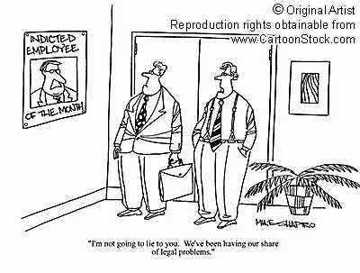
What is Fraud?
Fraud has these elements:
Misrepresentation
of a material fact
with the intent to deceive

Slide 7

Who Commits Fraud?
People do!
Employees or management
Contractor personnel or government employees
Military or civilian
Companies can also be held responsible for actions of their employees
(Source: United States Air Force, “Fraud Awareness Training for COR-QAE Training Module” October 2008)

Slide 8
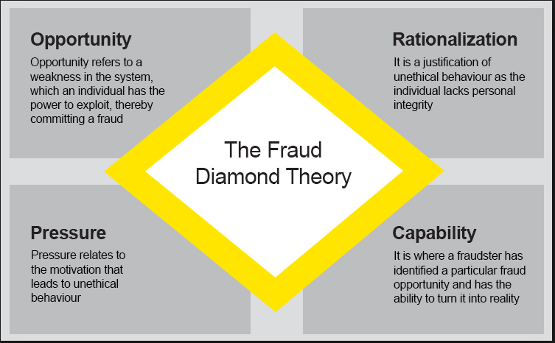
Why Do People Commit Fraud: Fraud Diamond Theory

Slide 9
Fraud Detection

Slide 10
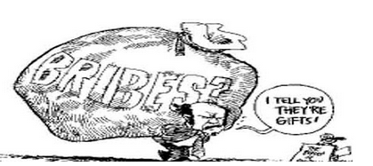
Fraud Detection: Common Types of Fraud
False claims / false statements
Mischarging: overcharging, defective pricing
Product substitution / Counterfeit parts
Kickbacks, bribery, gratuities, conflict of interest
Theft of government property
Embezzlement
Computer crimes
Collusive bidding/bid rigging/price fixing/antitrust

Slide 11
Fraud Detection: Types of Investigations
Criminal – Potential violations of Federal law punishable by imprisonment, fines, restitution or probation.
Civil – Civil matters may be addressed during a criminal investigation or as the sole focus of an investigative proceeding and are generally punishable by fines. Double and treble damages may apply in False Claims cases.
Administrative – The act committed or the alleged infraction involves violations of Federal rules or regulations. Can apply to individual and/or organizations and leads to corrective actions, systematic changes, employee removal and/or suspension, monetary recoveries.

Slide 12
Fraud Detection: Red Flags
Frequent sole source contracts / non-competitive awards
Unusually high indirect charges
Double / inflated charges – have to frequently be contested
Frequently disallowed costs
Lack of supporting documentation
Supporting documents for invoices look “created”
Notes:
-

Slide 13
Fraud Detection: Red Flags (cont.)
Contractor has poor management officials
Restriction of records / original records not available
Charging maximum allowable price on invoices
Poor internal controls
Project milestones / deliverables are constantly delayed

Slide 14
Fraud Prevention

Slide 15
Fraud Prevention: What Can You Do To Combat Fraud?
Watch for “red flags” when performing duties
Be a skeptic (low estimates, quick turnaround, sole source, etc.)
Be accessible to hear complaints from project managers, technical reps, contractors, and subcontractors
Provide OIG contact information to contractors and subcontractors
When in doubt, ask the OIG

Slide 16
Fraud Prevention: What Can You Do To Combat Fraud?
Ensure all purchases are legal, proper, reasonable and satisfy a bona fide need
Maintain all purchase card records and documentation
Approving Officials, perform their duties diligently and judiciously
Maintain separation of purchase card holder, hand receipt holder, and approving official
Have a copy of the contract and all modifications readily available

Slide 17
Fraud Prevention: What Can You Do To Combat Fraud?
For Contracting Personnel
Become familiar and remain current on terms, conditions and requirements of the contract
Verify the reasonableness of the contractor’s invoiced costs under a cost reimbursement type contract
Use performance language in the statement of work expressing only the governments actual minimal needs
Ensure that any required reports from you or the contractor are complete, accurate, and timely

Slide 18
Fraud Prevention: What Can You Do To Combat Fraud?
For Contracting Personnel (cont’d)
  Monitor the work performance by the contractor in accordance with the surveillance plan
  Inform the contractor immediately regarding unsatisfactory performance; differences of opinion should be referred to the Contracting Officer (CO) for resolution
Correct unsatisfactory work
COR’s report serious or major problems to the CO immediately, don’t wait until your next scheduled report

Slide 19
Ways to Report Fraud to the OIG?
GPO employees should report to the OIG – matters related to fraud, waste, and abuse in GPO programs and services, to include violations of law, rules, or agency regulations, mismanagement, and gross waste of funds.
  This may include issues related to contract fraud and other financial crimes.
To reach the OIG Hotline:
  1-800-743-7574
  gpoighotline@gpo.gov
All reports to the OIG hotline will be treated as confidential.

Slide 20
Questions?

